Slide 1


Next-Generation Sequencing (NGS)
Contact:
BioSci 4325a
613-533-2353
bit.ly/colautti
robert.colautti@queensu.ca
Rob Colautti
Biological Sciences

Slide 2
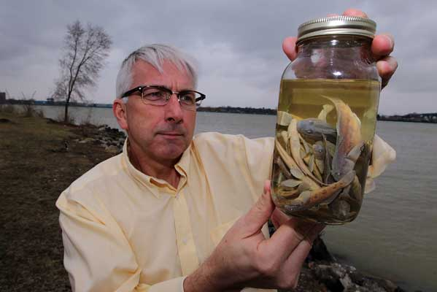
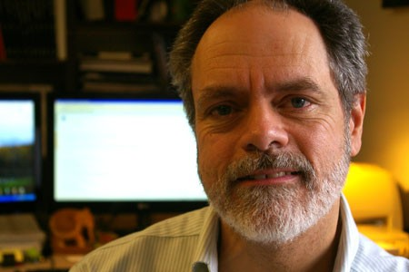

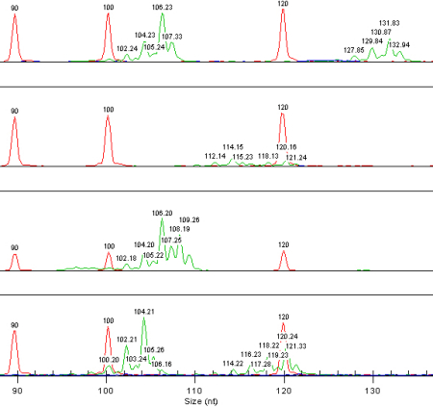

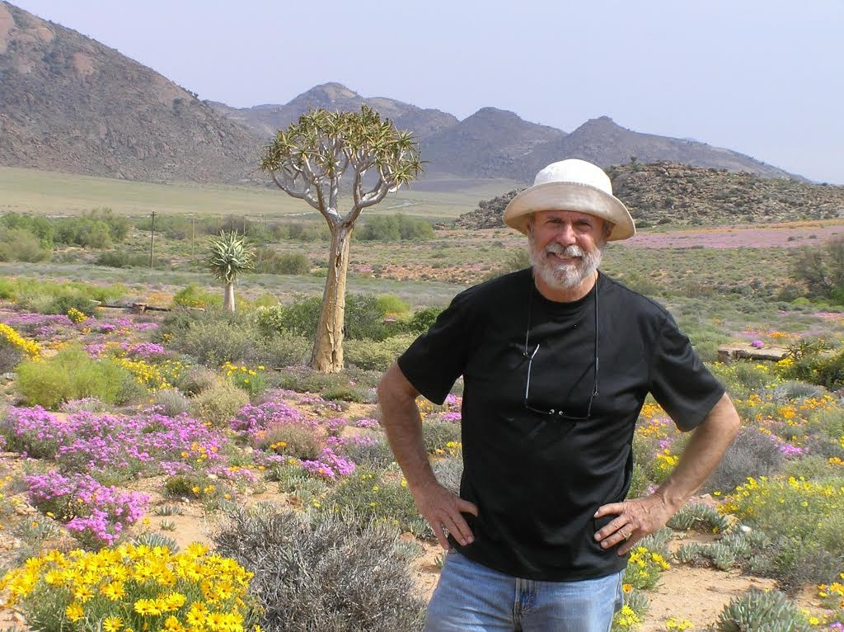
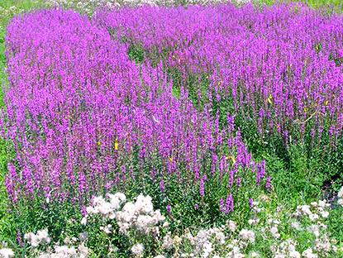
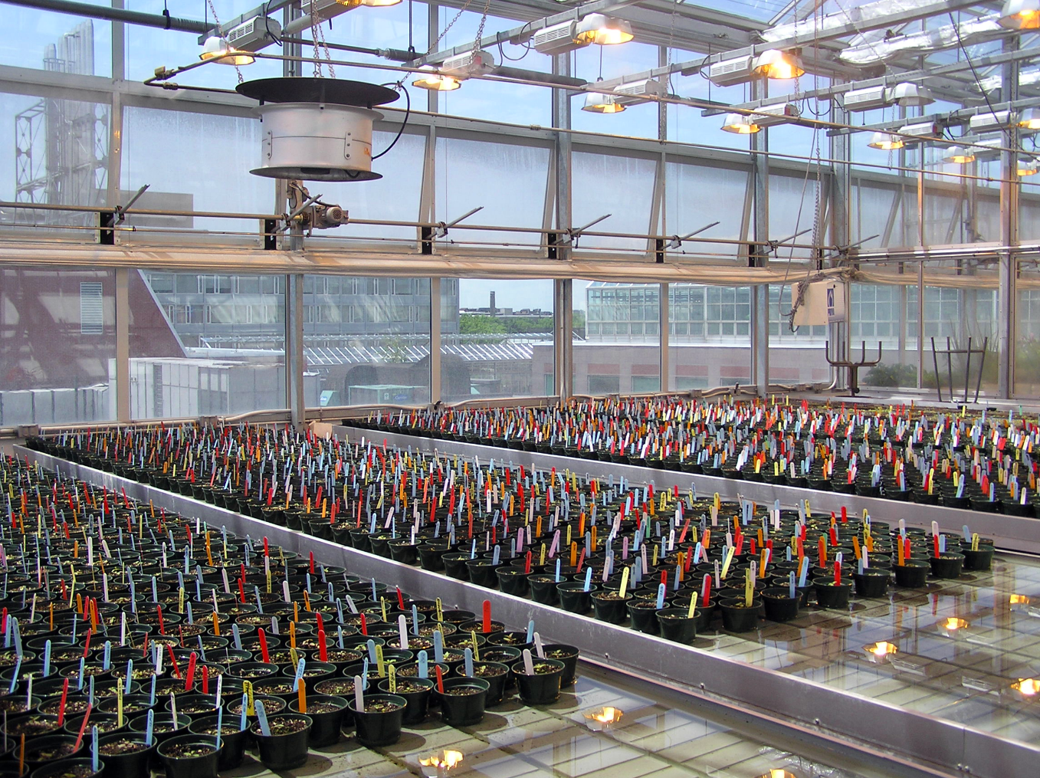
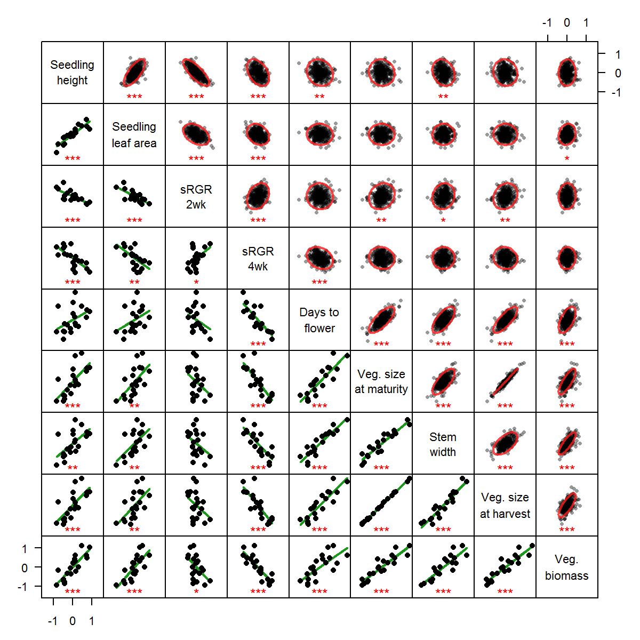
Research Background
University of Windsor & GLIER – Hs Bsc, MSc
Windsor, ON
Hugh MacIsaac
Dan Heath
University Toronto – PhD
Toronto, ON
Spencer Barrett

Slide 3
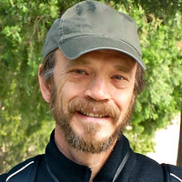

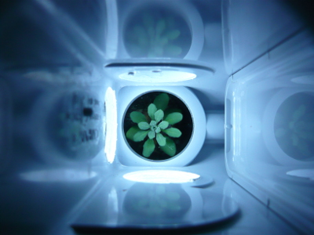
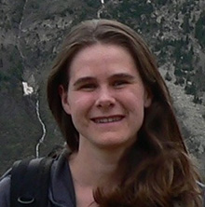
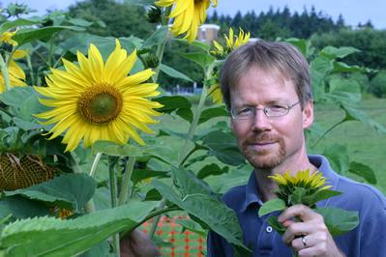
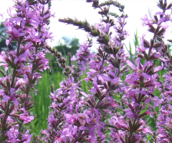
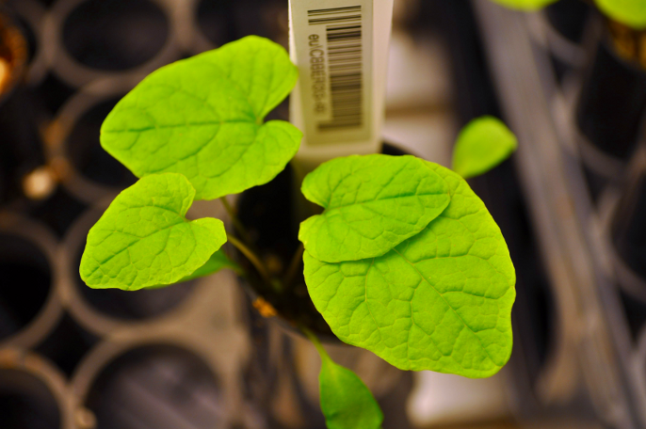
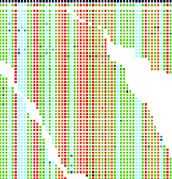
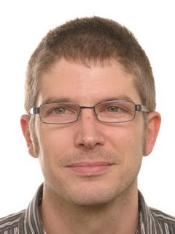
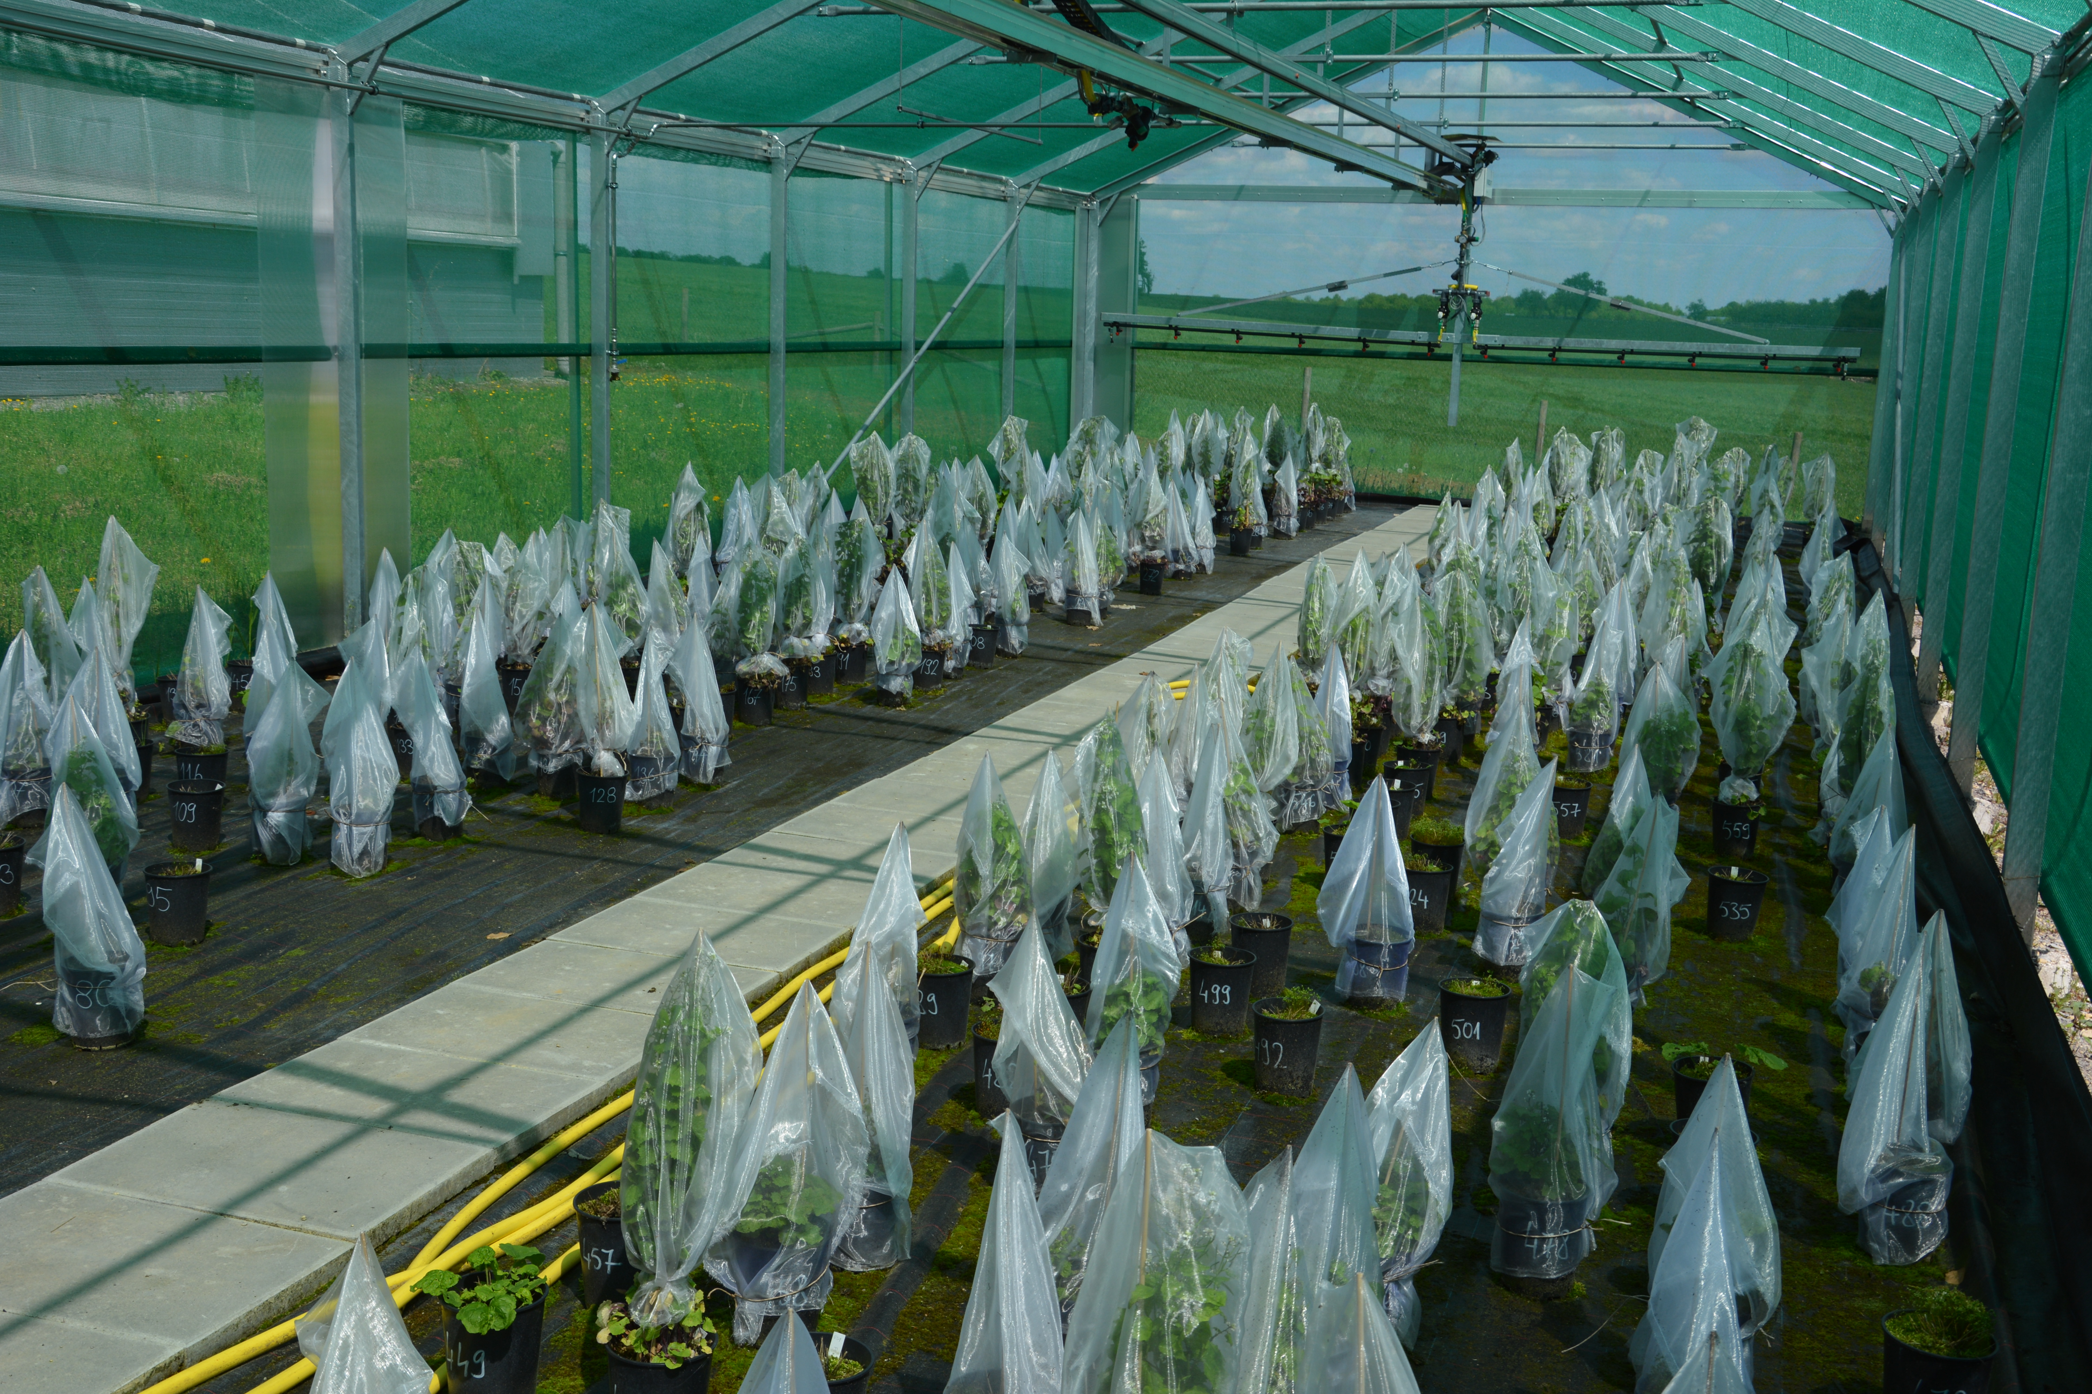
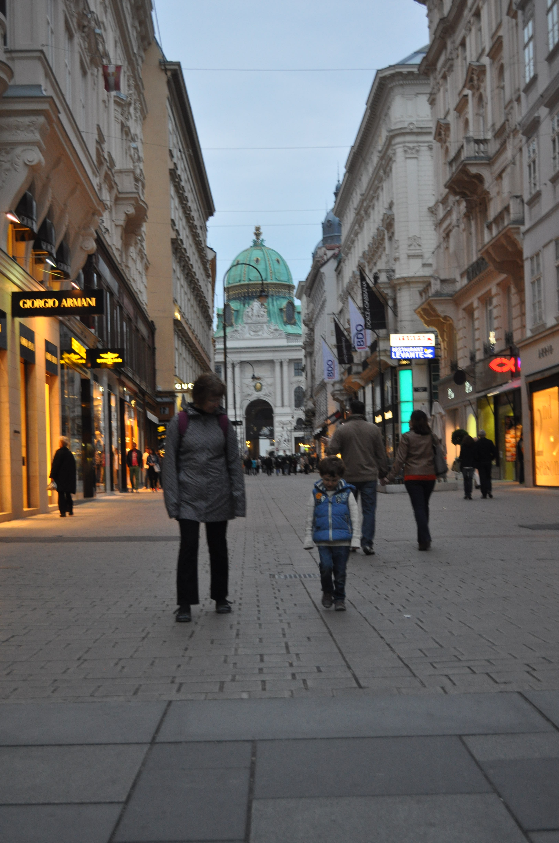
Research Background
Duke University – Postdoc
Durham, NC
Tom Mitchell-Olds
Jill Anderson
University of British Columbia – Postdoc
Vancouver, BC
Vancouver, BC
Loren Rieseberg
University of Tuebingen – Postdoc
Tuebingen, DE
Oliver Bossdorf

Slide 4
Overview
What is Next-Generation Sequencing (NGS)?
How does NGS work?
Why is NGS revolutionizing the biological sciences?

Slide 5
Introduction to NGS

Slide 6
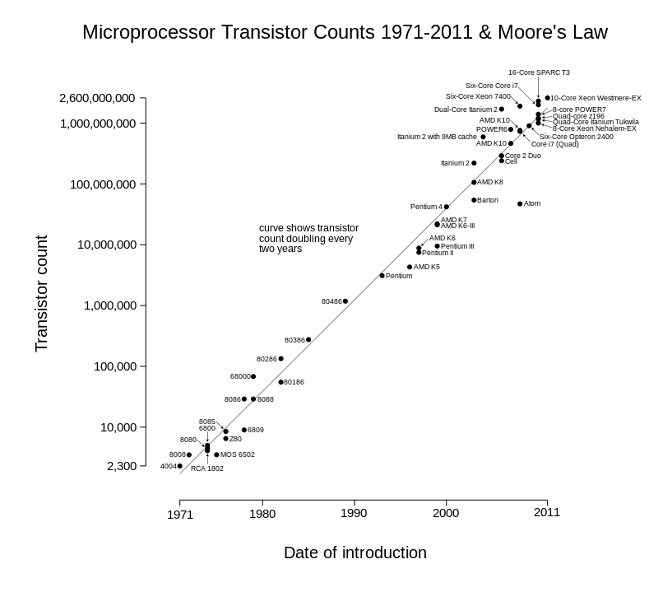
Moore's Law
"the number of transistors in a dense integrated circuit doubles approximately every two years"
-- Wikipedia (Feb 2, 2016)
Notes:
ask for definition

Slide 7
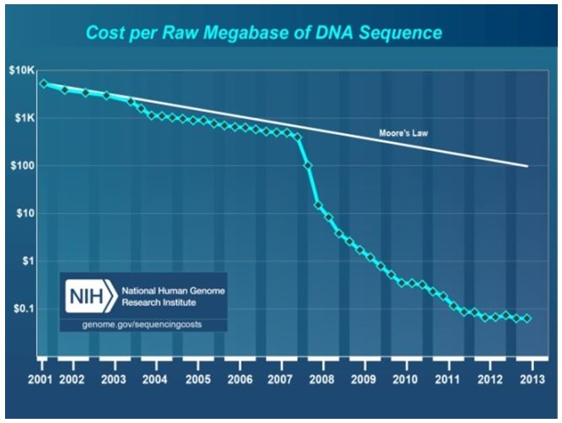
Moore's Law vs DNA Sequencing technology
Notes:
Anyone know what happened ~2008?

Slide 8
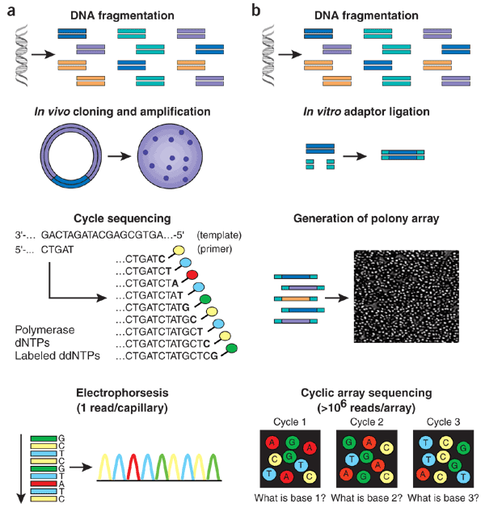
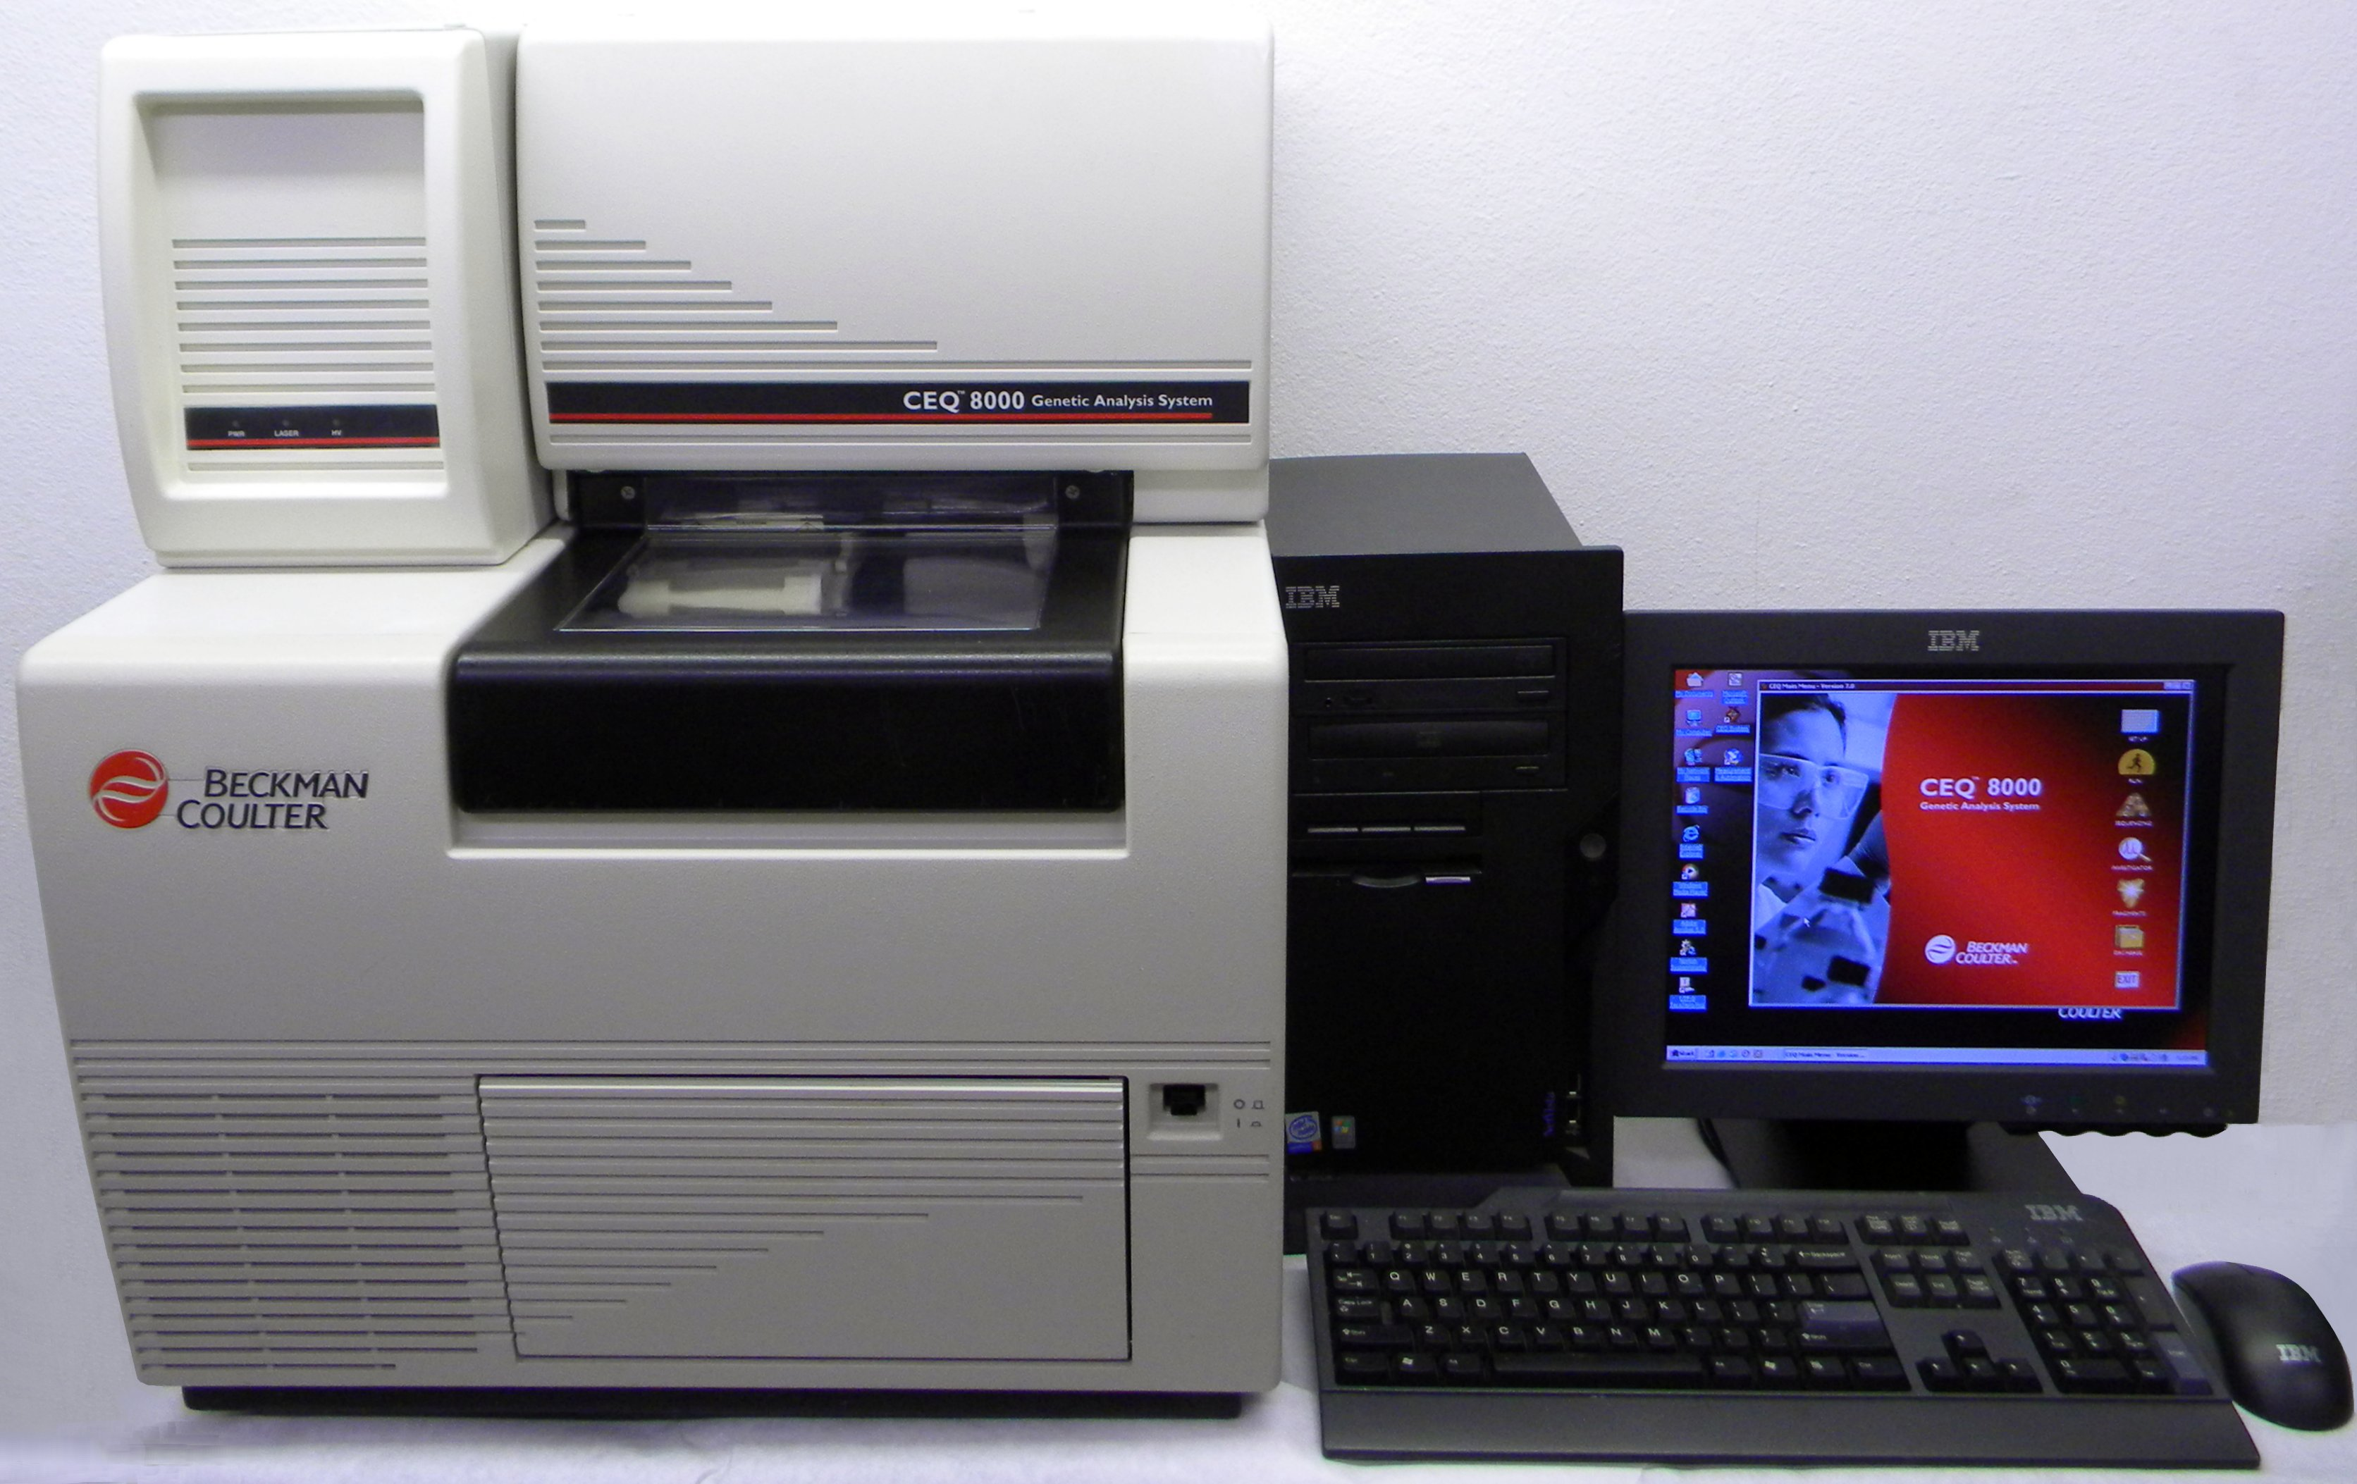
Sanger Sequencing
Dideoxy
chain
termination
sequencing
Beckman Coulter CEQ 8000
Notes:
CEQ ‘state of the art’ – banks machines for human genome

Slide 9
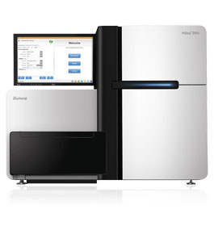
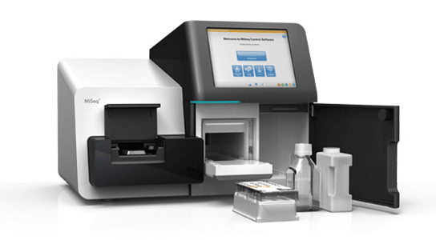
Next-generation sequencing (NGS)
Sequencing
by
synthesis
Illumina HiSeq & MiSeq

Slide 10
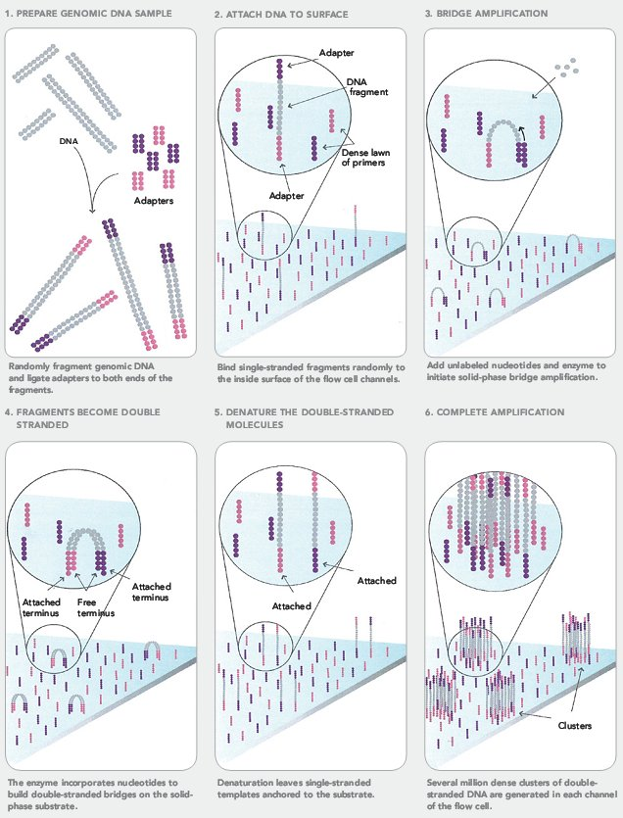
Illumina (Sequencing by synthesis)
1
2
3
Shear DNA into short fragments (~100-500bp) & ligate sequencing primers (adapters)
Attach DNA to surface
Bridge amplification
4. Fragments become double stranded
5. Denature the double stranded molecules
6. Cluster amplification
4
5
6
Illumina.com

Slide 11
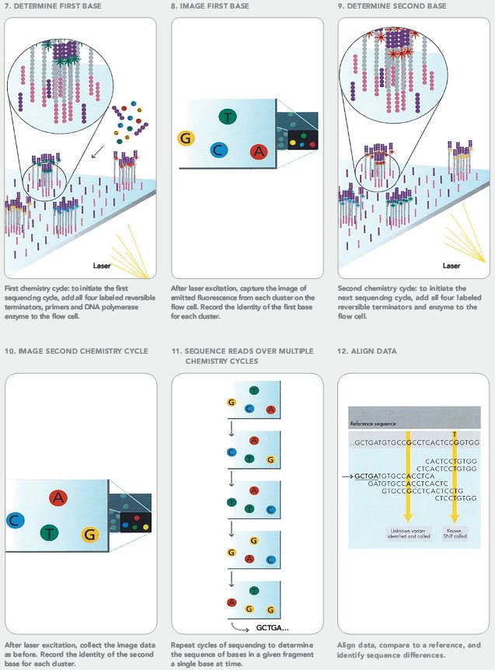
Illumina
7
8
9
7. Add fluorescent-labelled nucleotides
8. Image first base
9. Flush flow cell and repeat
10. Image second base
11. Sequence reads over multiple cycles
12. Align data
10
11
12
Illumina.com

Slide 12
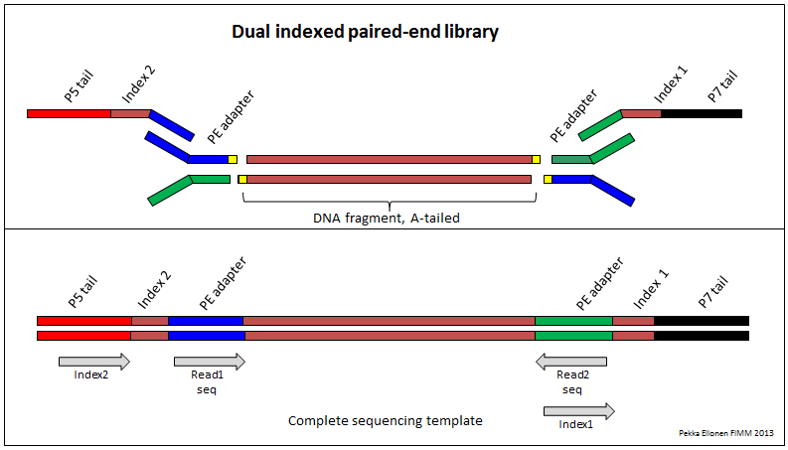
DNA construct

Slide 13
Advantages of Illumina
Versatile (see applications later)
Economic (price per Mb of data)
MiSeq – up to 2 x 300bp x 15M reads = 9 Gb
~$2,500 ($0.27)
HiSeq – up to 2 x 125bp x 200M reads = 50 Gb
~$3,000 ($0.06)
Compare Platforms:
http://www.molecularecologist.com/next-gen-fieldguide-2016/

Slide 14
Other NGS Platforms
PacBio – longest reads (>20kb)
genome assembly and full-length cDNA sequencing
DNA structural differences (e.g. inversions, transposon jumps)
BUT: see 10x genomics for Illumina
Ion Torrent – Fewer reads (1 Gb)
Lower up-front investment ($80k vs $150k+ for Illumina)
pre-existing variant panels (model organisms)
Amplicon sequencing (e.g. microbiome)
User-friendly, fast turnaround
Roche 454 – Obsolete; Lowest throughput (1 Mb)
cheaper long reads (up to 1 kb)
Microbiome studies

Slide 15
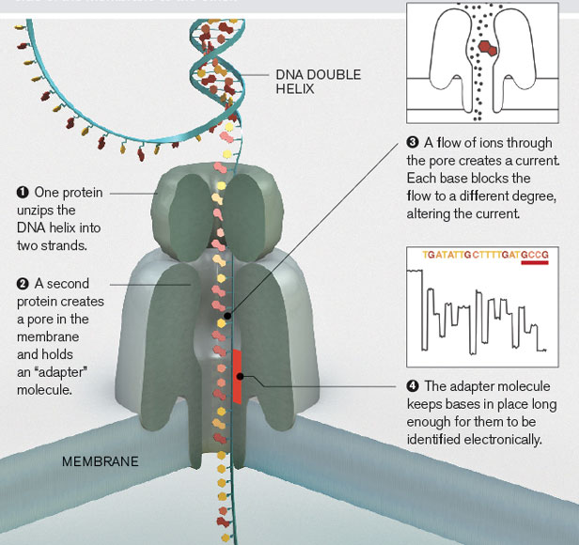
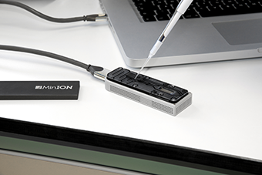
Experimental: MinION (Oxford Nanopore)
MIT Tech Review

Slide 16
Why is NGS revolutionizing Biology?
NGS-tools translate across disciplines. For example:
Metagenomics:
Soil, water, human gut microbiomes
Variant detection & GWAS
QTL mapping for agriculture, adaptive traits, environmental stressors, human health
Notes:
All organisms have RNA & DNA

Slide 17
Applications

Slide 18
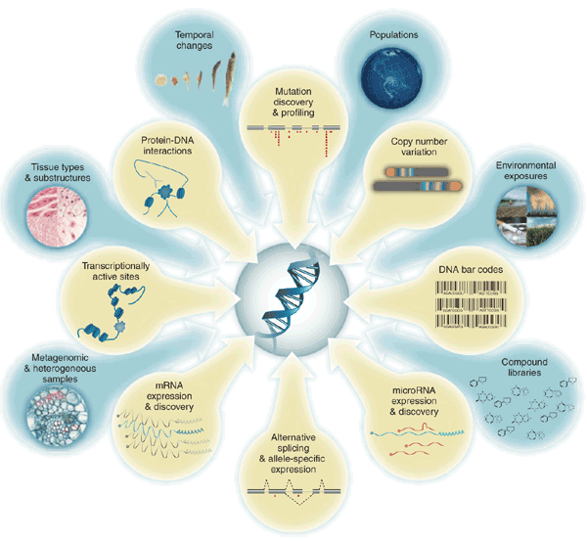
Applications
Kahvejian et al. (2008; Nature Biotech)

Slide 19
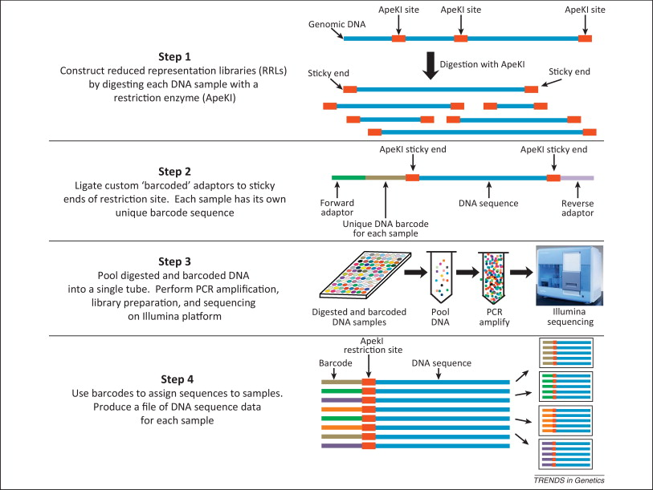
Genotype-by-sequencing (GBS)
Myles (2013; Trends Genetics)
Notes:
Applications (ask class)? GWAS,

Slide 20
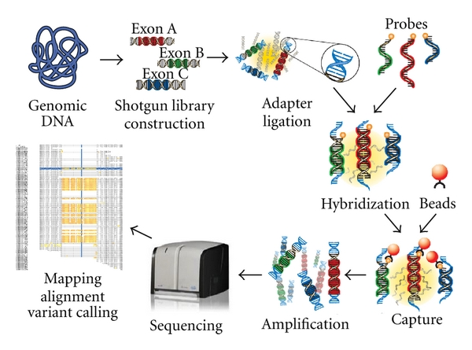
Target-capture sequencing

Slide 21
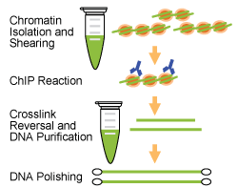
ChIP-seq (protein-targets)
Notes:
CHIP = Chromatin Immunoprecipitation

Slide 22
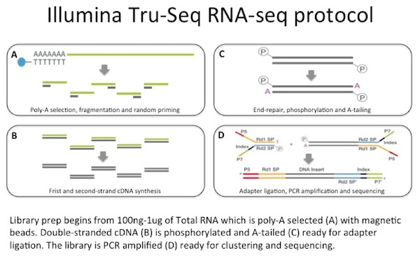
RNA-Seq
Illumina.com

Slide 23
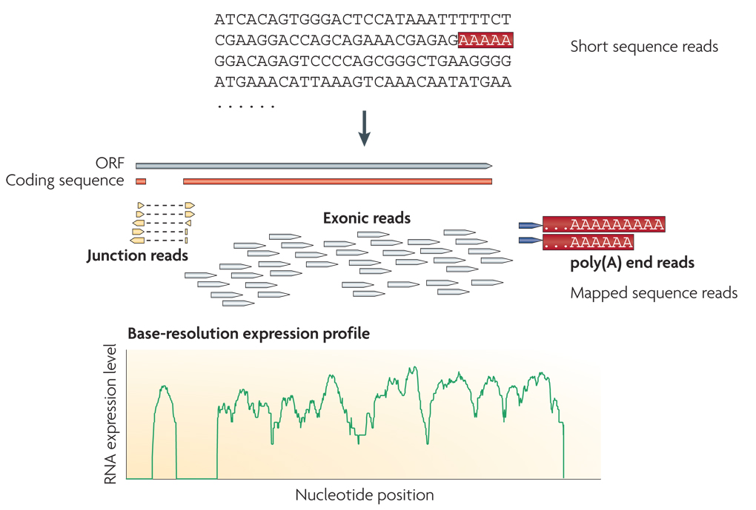
RNA-Seq expression profiles

Slide 24
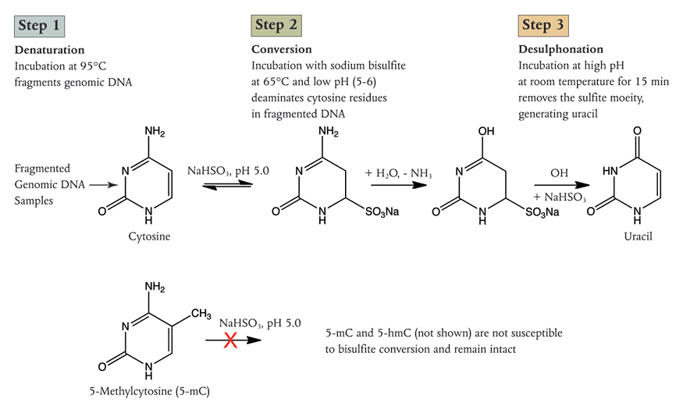
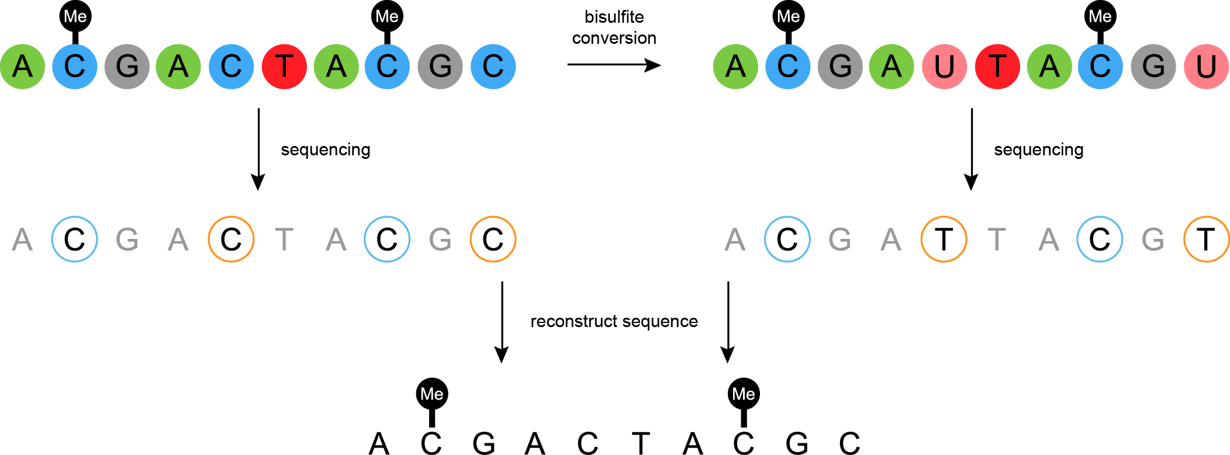
Bisulfite sequencing
\
atbio.com

Slide 25
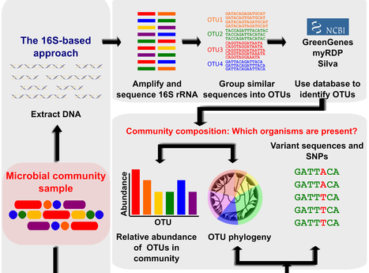
Metagenomics
OUT = Operational Taxonomic Unit

Slide 26
Whole-Genome Shotgun (WGS) sequencing
Extract
Fragment
Sequence
Align

Slide 27
Assembly with or without a reference
de novo assembly
'non-model' organisms
Alignment to reference
sometimes called 'resequencing'
common in 'model systems'
e.g. human, mouse, Drosophila, C. elegans, Arabidopsis
Reference genome
Consensus sequence
Contiguous consensus sequences
(contigs)

Slide 28
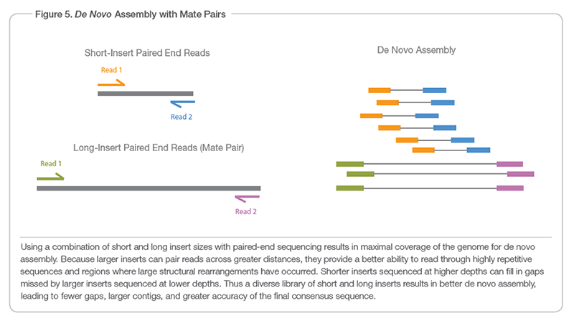
De novo assembly
IMPORTANT: Paired End vs Mate-Pair
Illumina.com

Slide 29
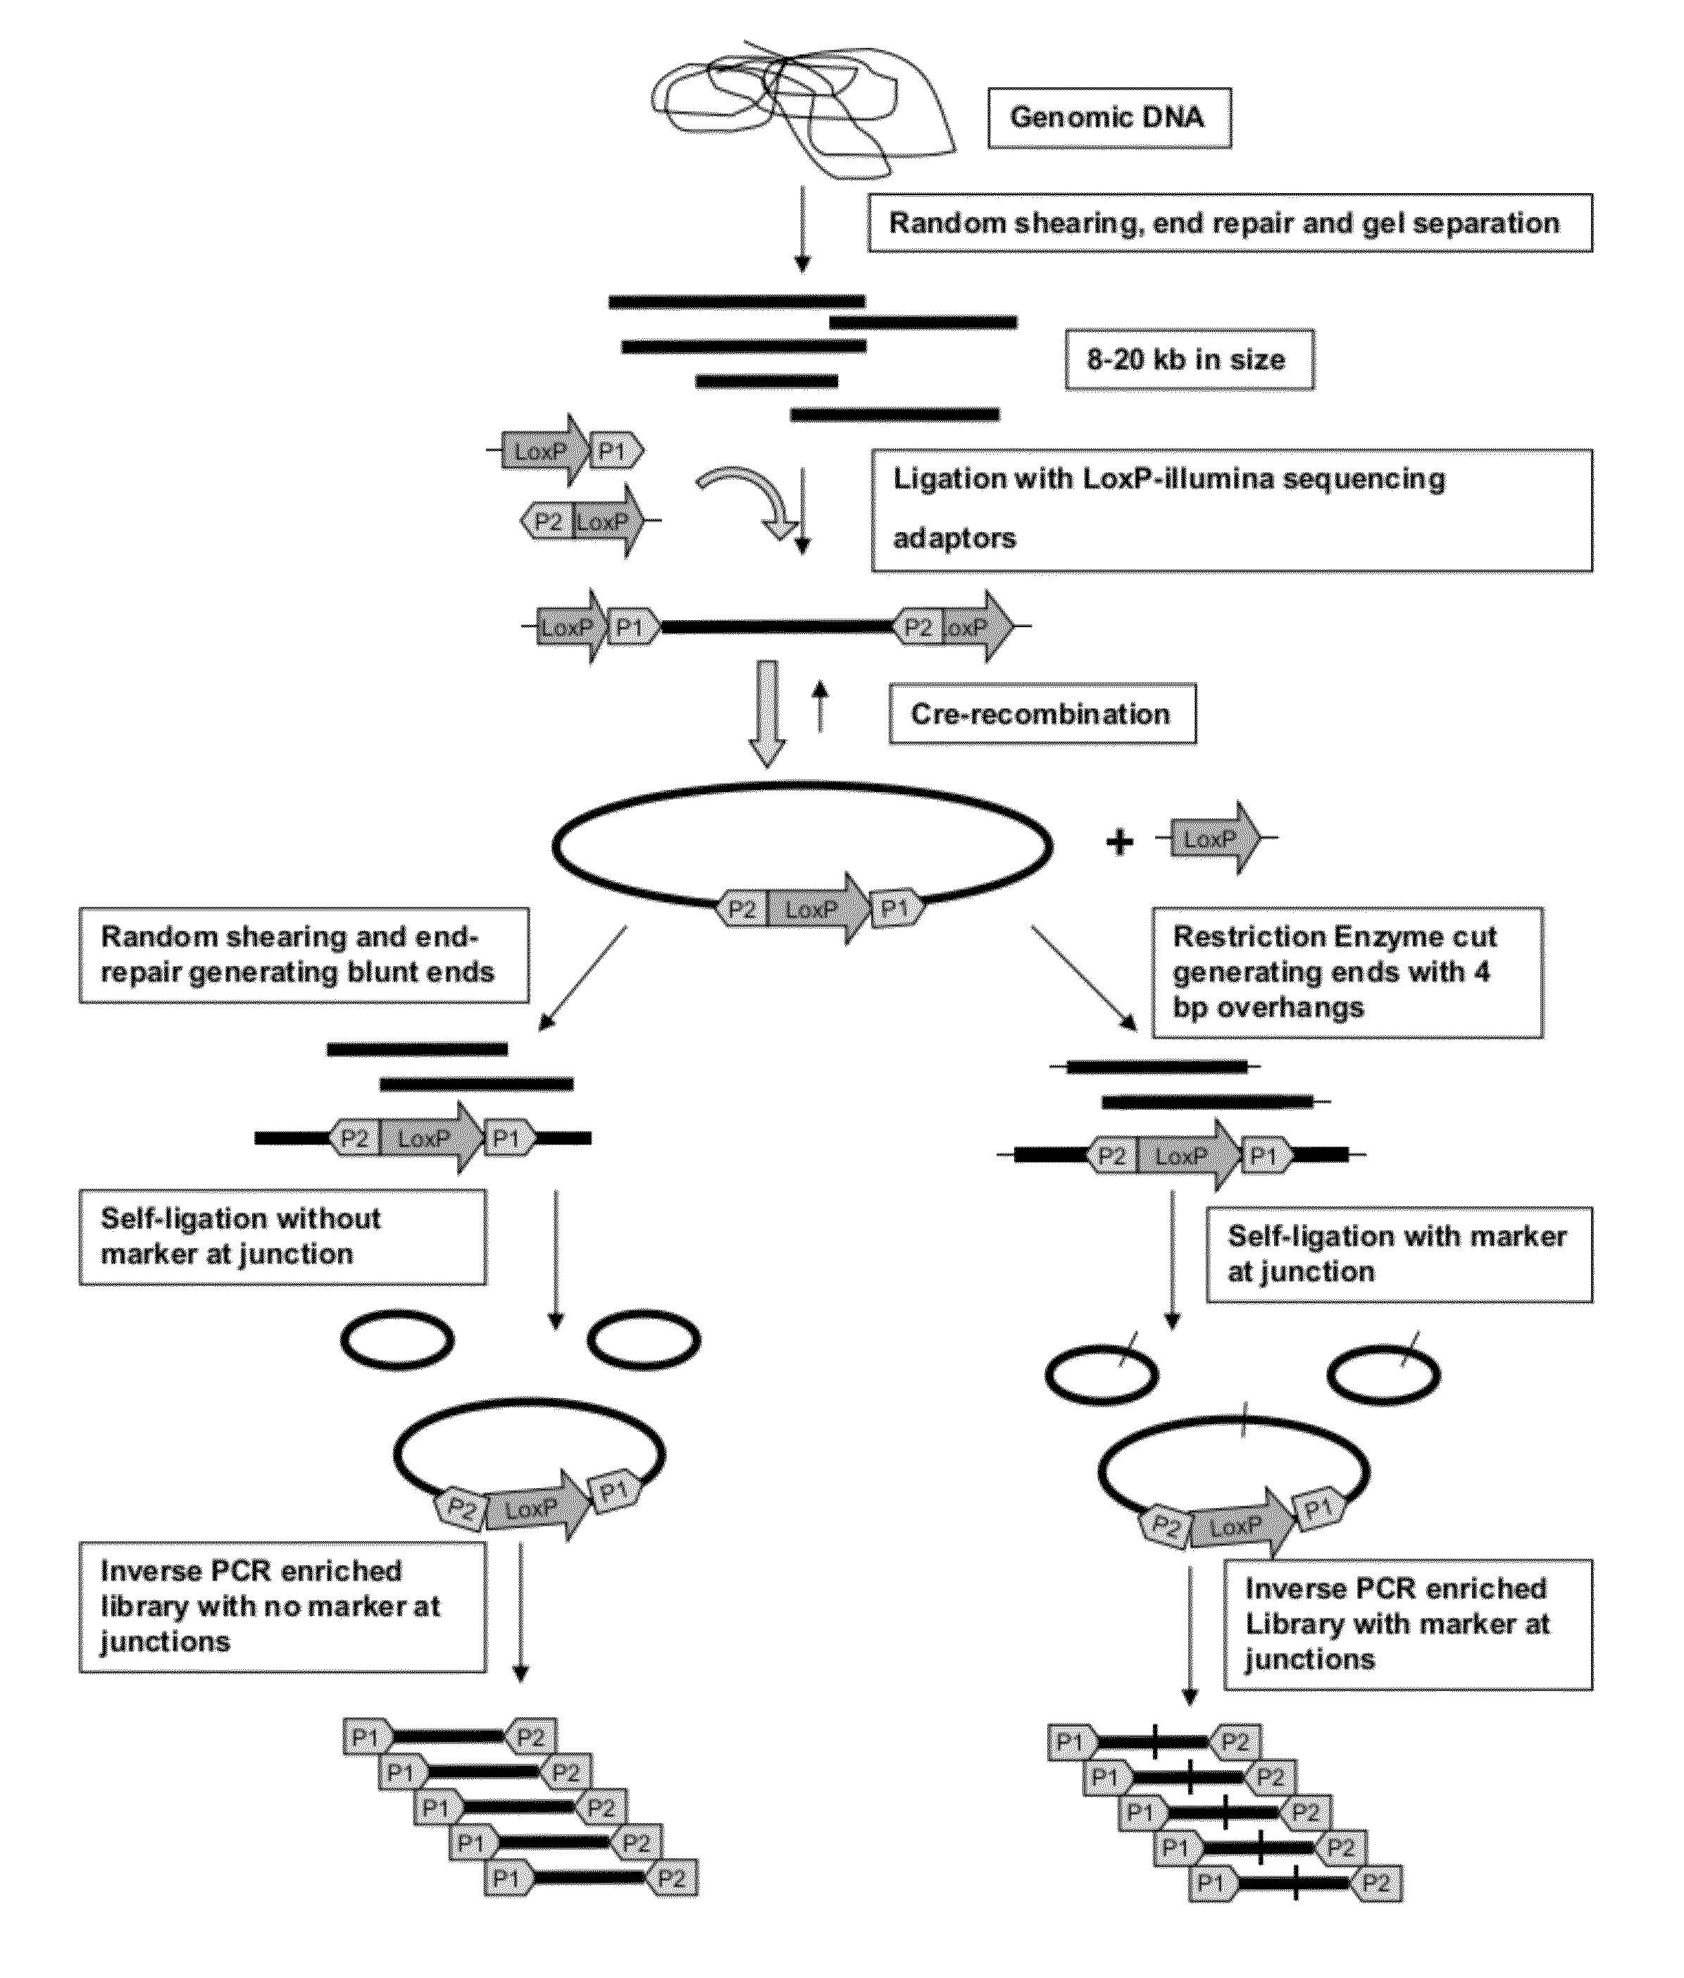
Mate pair library
http://www.google.com/patents/US20120329678

Slide 30
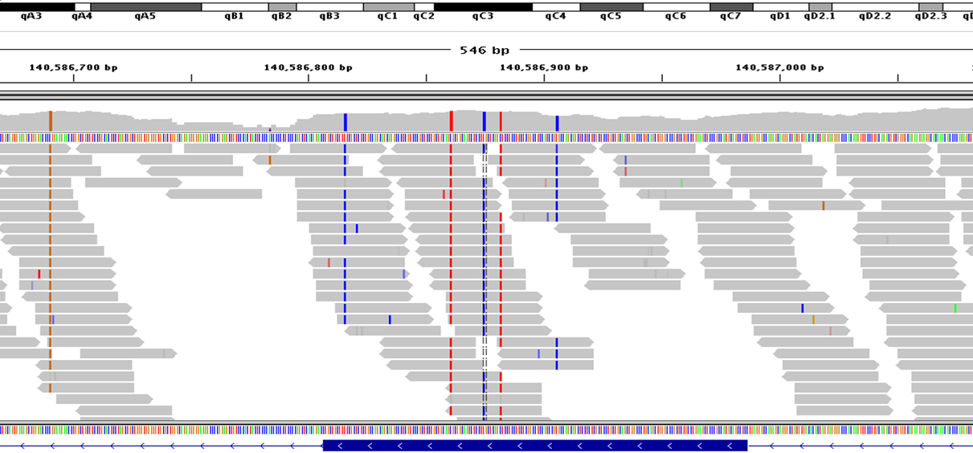
Coverage
LOW
HIGH
= average # reads at any given location (base pair)
A 'random' sampling process
(Higher is better)

Slide 31
de novo assembly programs*
ABySS
ALLPATHS-LG
CORTEX
CLC Genomics Workbench
DISCOVAR de novo
Geneious
IDBA
MaSuRCA
MIRA
PLATANUS
RAY
SOAP de novo
*Large genome assemblers (>0.5Gb)
Gold = commercial/restricted license

Slide 32
Challenges

Slide 33
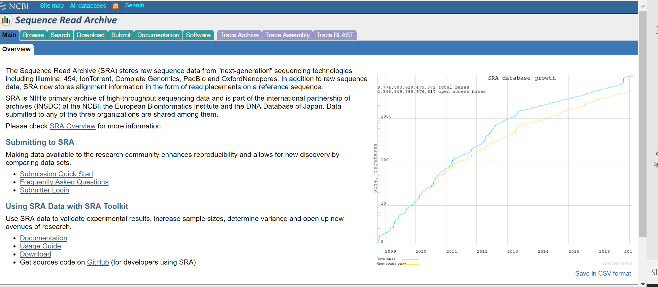
‘Big Data’ Computation
https://trace.ncbi.nlm.nih.gov/Traces/sra/

Slide 34
‘Big Data’ (~10 Petabytes)

Slide 35
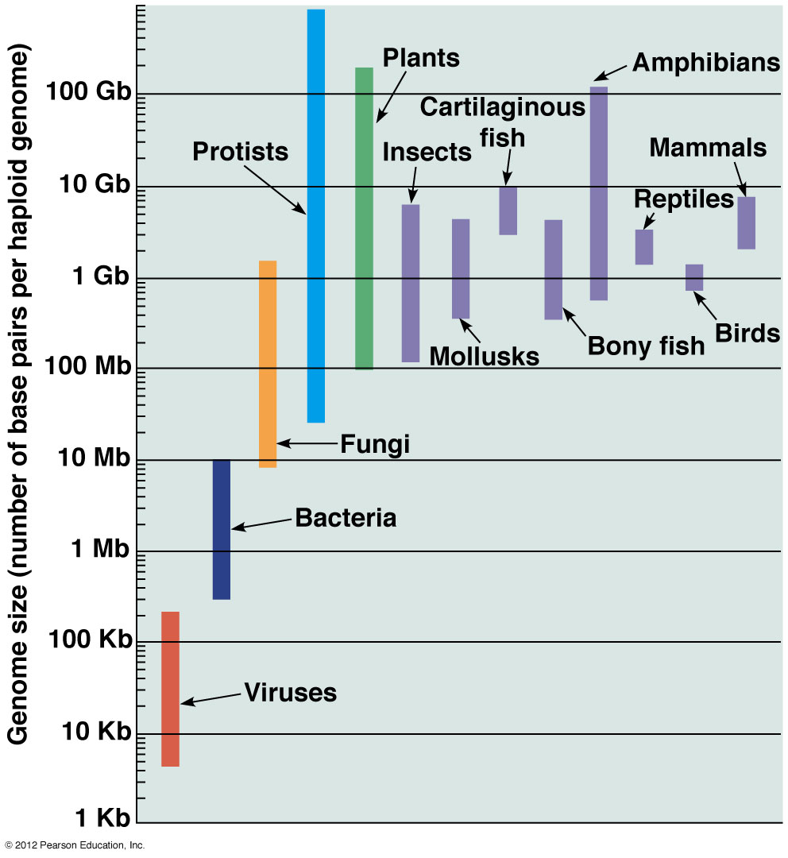
Large genomes
Human
(~3.2Gb)

Slide 36
Assembly challenges
Large repeats – creates gaps
Errors – cannot be assembled
Low coverage – creates gaps
Unequal coverage – confuses error correction

Slide 37
NGS and Ecological Genomics
in the Colautti Lab

Slide 38
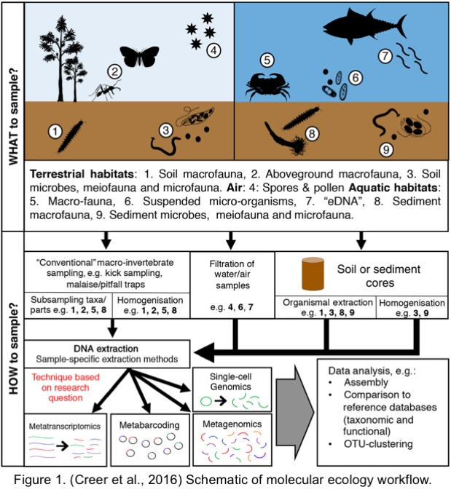
Ecological Genomics

Slide 39
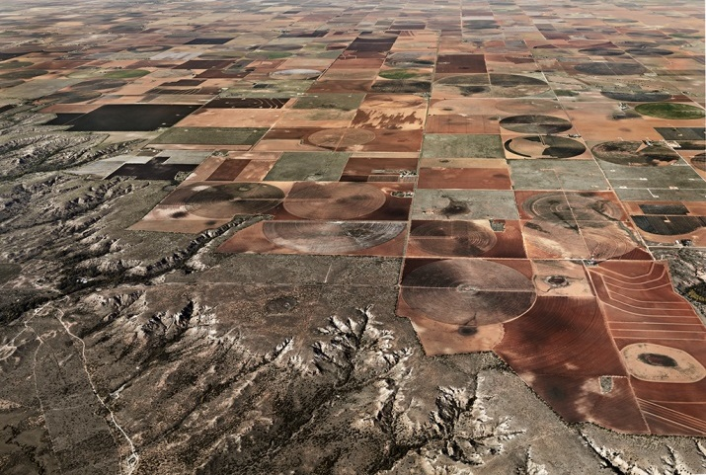
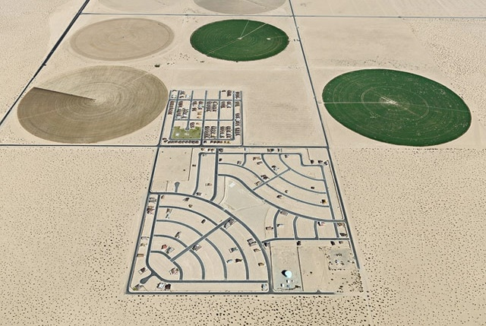

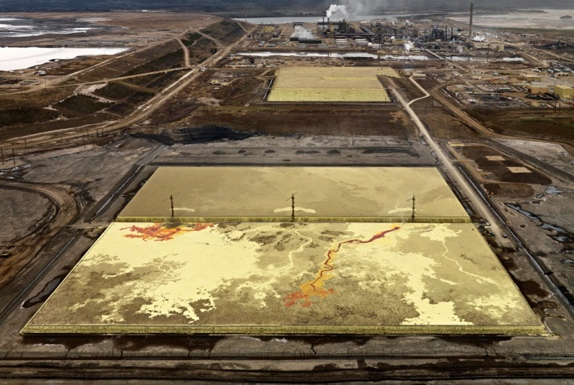
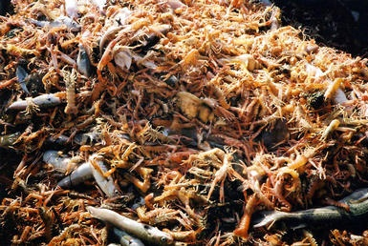
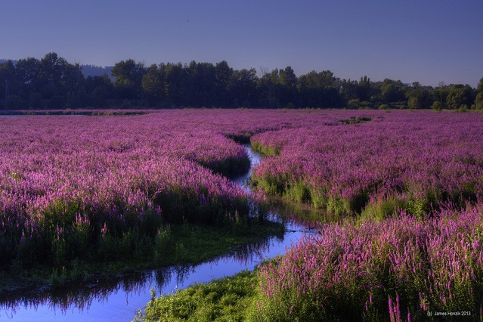
Ecology and Evolution in the Anthropocene
Magellan I Sverige
James Hoznik
Environment --> Natural Selection --> Genome Evolution
Photos by Ed Burtynsky (mostly)

Slide 40
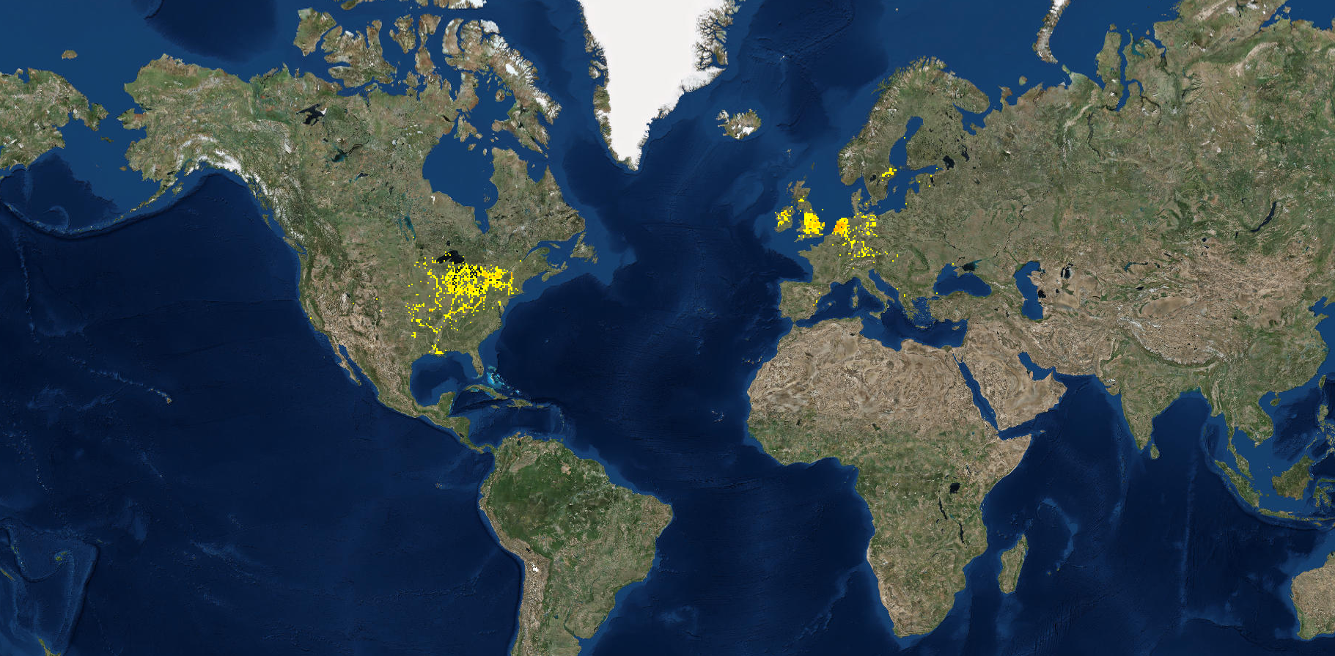
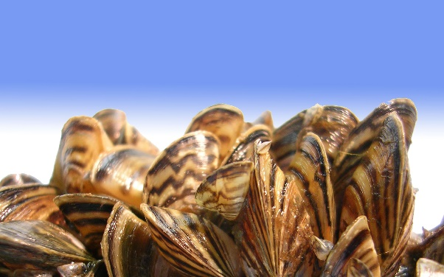
Ecological genomics of invasive species
USFWS
Dreissena polymorpha
gbif.org

Slide 41












Invasions: grand, unplanned ecological experiments

Slide 42







eDNA and DNA barcodes for environmental monitoring
Barcode of Life Project
www.boldsystems.org
https://www.youtube.com/watch?v=ZImiXgU6bCk

Slide 43



Tick microbiome analysis
Lyme disease in Canada (cbc.ca)
Ixodes scapularis (black-legged tick)

Slide 44
NGS @Queen’s
Biology Department has the only Illumina sequencer on campus (MiSeq)
Other machines (IonTorrent, microarrays) spread across campus
Queen’s has no university-wide genomics core facility – very unusual for a research-intensive university

Slide 45
NGS @ Queen’s: Typical WGS sequencing workflow
Library Prep
Extract & Purify DNA
Fragment and size-select
Sequencing
Generate FASTQ file – includes sequence data (short-reads) and quality score
Assembly
Assemble short-reads into contigs and scaffolds
Ligate sequencing primers
Analysis
e.g. genome annotation; comparative genomics; structural variant detection; taxonomy ID (metagenomics); align short reads for variant detection (e.g. for GWAS)

Slide 46


QC @ Queen’s
Agilent Bioanalyzer

Slide 47
MiSeq @ Queen’s

Slide 48





de novo sequencing Application
Ecological genomics
of
Alliaria petiolata
Loren Rieseberg
Oliver Bossdorf

Slide 49


Why Alliaria petiolata?
Problematic invasive species in North America
Easy to identify
Simple lifetime fitness estimate
Brassicaceae, self-pollinated
Ecologically important chemistry
(Enemy release; allelopathy/soil biota)
Year 1
Year 2

Slide 50

Alliaria petiolata ecology: plant-microbe interactions

Slide 51


Alliaria petiolata ecology: plant-microbe interactions
Mycorrhizal fungus
Root

Slide 52

Alliaria petiolata ecology: plant-microbe interactions

Slide 53
Global garlic mustard field survey
International collaboration
164 participants from 16 countries
Field surveys
45,000 field measurements
Plant performance traits
Herbivory & fungal damage
Genetic resource
Seeds from >5,000 plants
395 locations across Europe and North Am.

Slide 54
Population genomics: Some major questions
How many introductions to North America, from which parts of Europe, and how has it been moved around?
Which genes affect survival and reproduction in response to:
cold vs warm climates
wet vs dry conditions
native vs introduced range
herbivores and pathogens
competition with other plants
Does selection act mainly on a few loci with large effects on phenotype, or many loci with smaller effects?
How important is standing genetic variation vs new mutations?
How important are SNPs vs genome rearrangements?

Slide 55

Alliaria petiolata draft chloroplast genome 153,190 bp

Slide 56

de novo assembly (Sanger)

Slide 57

de novo assembly (NGS)
de Bruijn graph method
based on k-mers

Slide 58

de novo assembly (NGS)
de Bruijn graph
‘bubbles’ in the assembly

Slide 59
De novo assembly
In practice
$ tar -zxvf CAC_files.tar.gz /home/hpc####

